Slide 1
If you build a dashboard, will they come? Implementing and using dashboards in the community
W05
Peter Balvanz
Boston Medical Center
Peter.Balvanz@bmc.org

Slide 2
Learning Objectives
After participating in this session the learner should be better able to:
Understand a primary purpose for dashboards as part of the HEALing Communities Study
Learn how we initially shared dashboards and engaged community members with their data.
Learn community suggestions for improved engagement and our response
Understand how Massachusetts used dashboards triangulated with other data to engage community members in data-driven decision-making

Slide 3
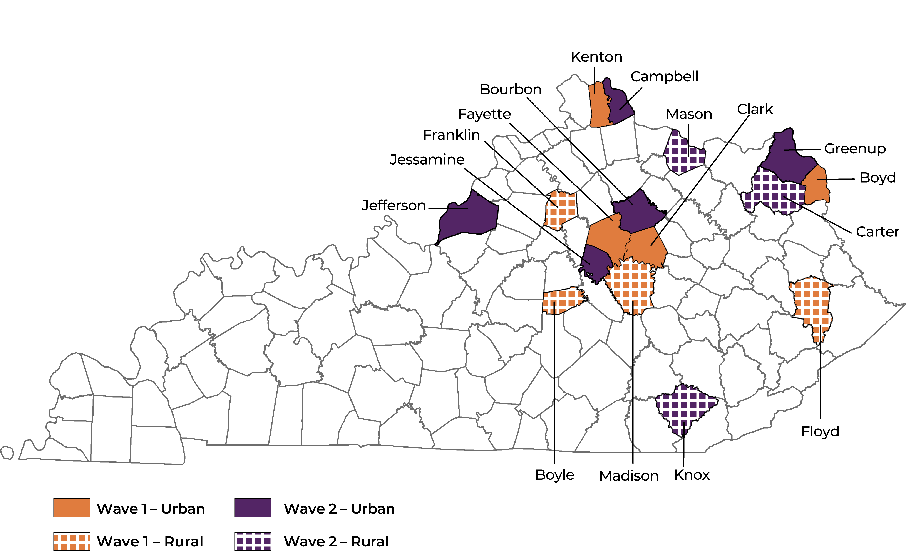
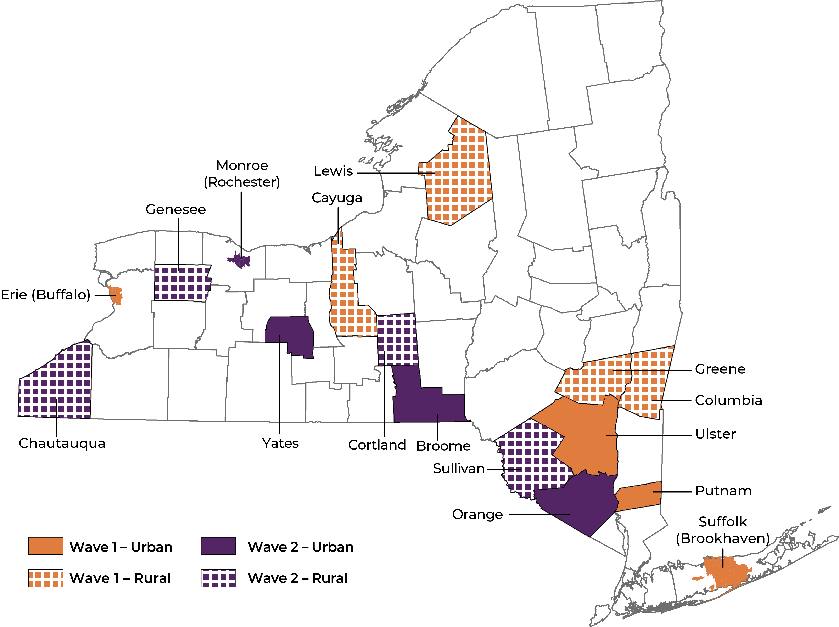
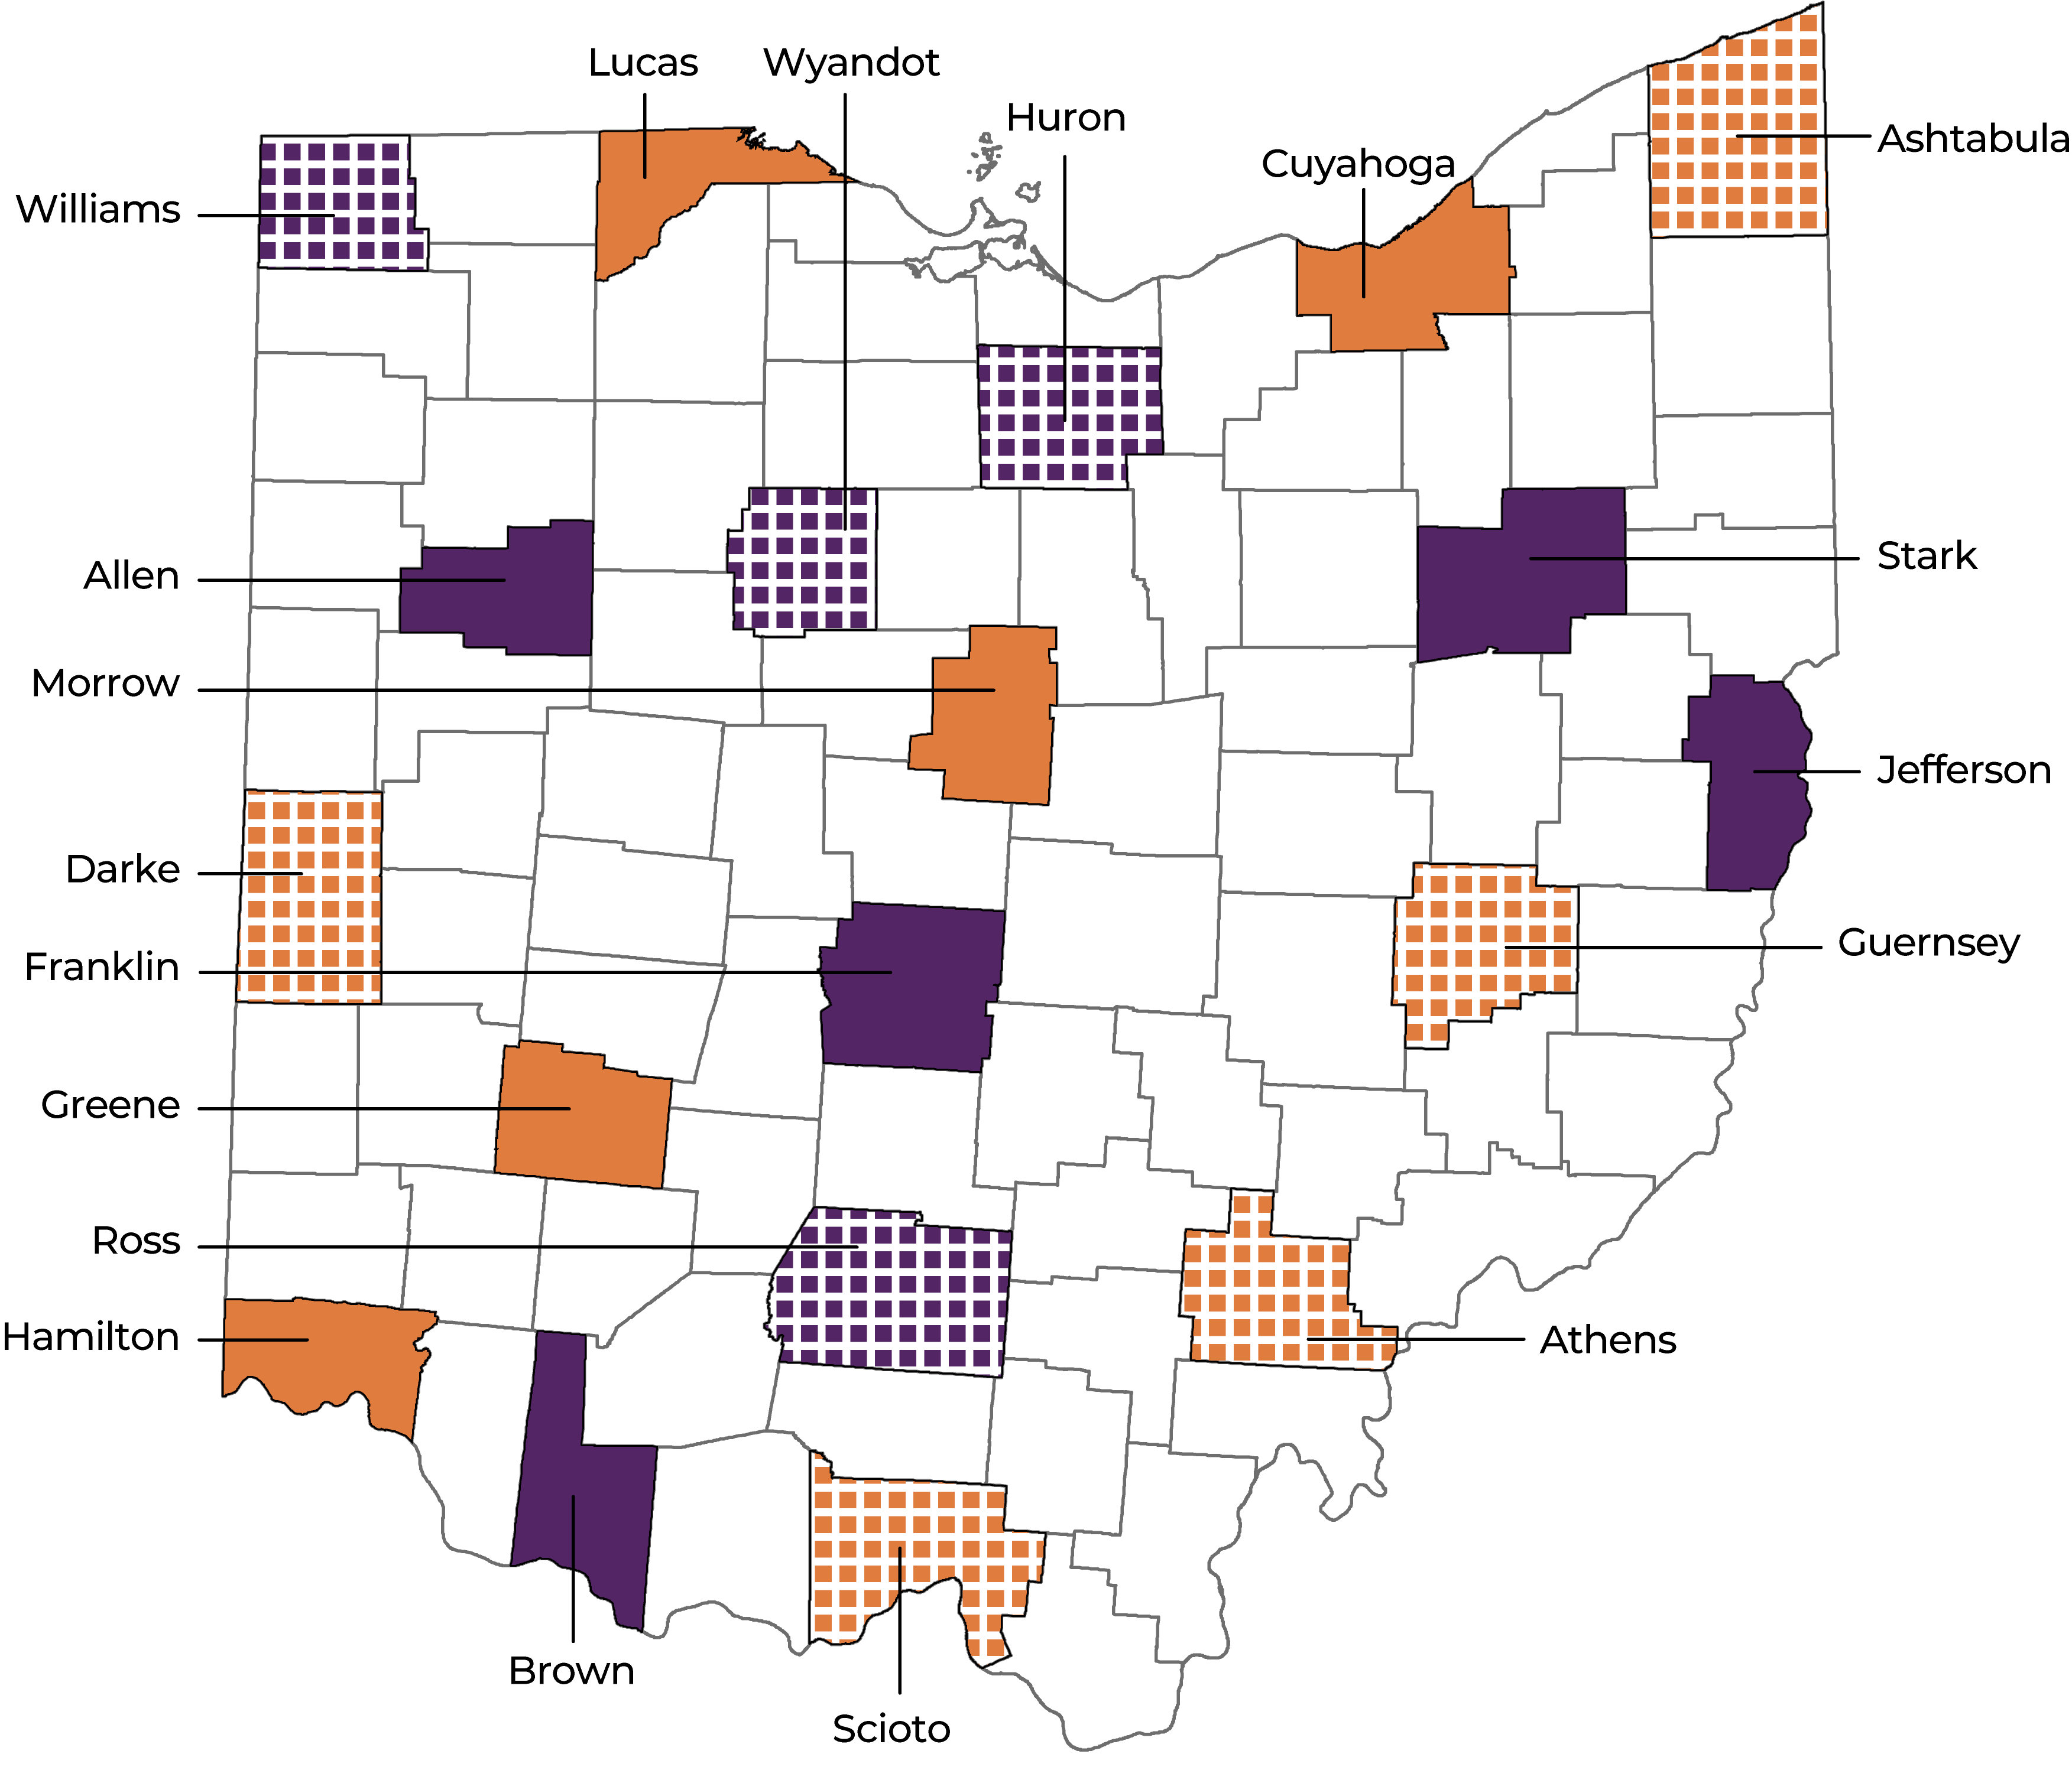
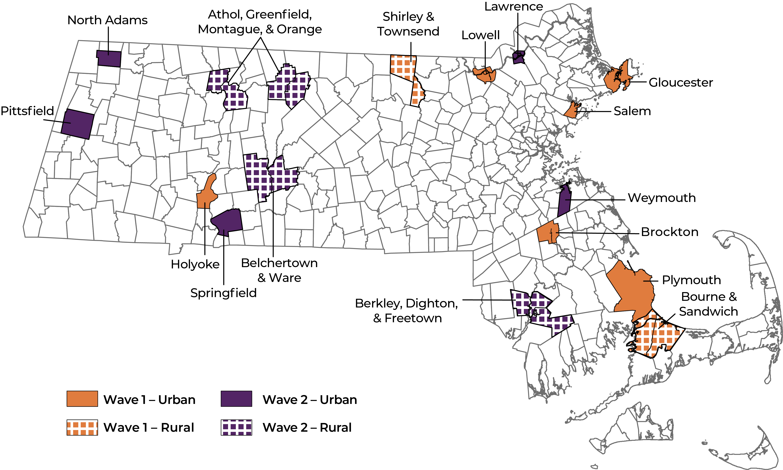
HEALing Communities Study (HCS)
April 2019 – NIH and SAMHSA funded KY, MA, NY, OH to work with 67 highly affected communities to reduce opioid overdose deaths by implementing a process to deliver evidence-based practices.
Wave 1: Jan 2020 – Jun 2022
Wave 2: Jul 2022 – Dec 2023

Slide 4
What is the goal of HCS?
To reduce opioid overdose deaths through implementation of evidence-based practices
Increase overdose education & naloxone distribution (OEND)
Increase access to medications for opioid use disorder (MOUD)
Increase safer opioid prescribing & dispensing practices

Slide 5


Why Dashboards? Data-Driven Decision Making
Key tenet of HCS is using data to guide and inform decision making:
“Developing a culture of data-driven decision-making with the use of data dashboards.”
“…multi-stage, data-driven, community engagement strategy.”
Source: HCS Protocol, Walsh et al. DAD 2020.

Slide 6
Communities That Heal (CTH) Intervention
Establish coalition and charter
Discuss evidence-based practices (EBP)
Review data, identify gaps
Develop Action Plans - select EBPs
Implement and monitor EBPs
Pursue sustainability
Source: HCS Protocol, Walsh et al. DAD 2020.

Slide 7
Review Data, Identify Gaps
Phase 3: Data Dashboards, Community Profiles
Engage Coalition, CAB and other Key Stakeholders on the content, visualization and use of the Community Profile and Data Dashboard
Trainings on data collection and data visualization
Co-creation of Data Dashboard
Co-creation of Community Profile

Slide 8
Data Staff and Tools

Slide 9
Data Engagement: Community Data Managers
POSITION SUMMARY:
We are seeking highly skilled individuals to integrate, translate, and disseminate community-level public health data as part of an opioid overdose reduction study in Massachusetts communities. Oversee the integration of community data into interactive web-based dashboards Synthesize, integrate, disseminate and understand study data Review data to inform coalition decisions

Slide 10
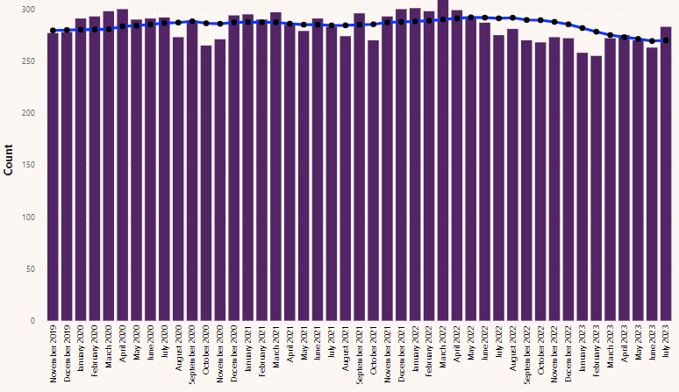
Data Visualization: Dashboard
PURPOSE
Monthly updated metrics on overdose and service access indicators
DATA
Fatal opioid overdose
Opioid-related EMS and ED visits
Naloxone distribution
MOUD census
High-risk prescribing
Community Buprenorphine Census

Slide 11
Data Visualization: Community Profile
PURPOSE
Baseline static socio-demographic, overdose, and resource indicators
DATA
Sociodemographics
Fatal opioid overdose
distribution
location
MOUD Access
Naloxone distribution
Uses Dashboard Data
Fatal Overdose

Slide 12
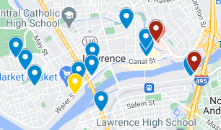
Data Visualization: Landscape Analysis
PURPOSE:
Baseline static distribution of community OUD resources
DATA
Google
Focus Groups
Key
Substance use disorder treatment and/or recovery program or provider
Harm reduction and/or syringe service program
Emergency department / hospital
Federally Qualified Community Healthcenter (FQHC) or primary care clinic

Slide 13
Wave 1 Dashboard Engagements
Providing Access
Data staff provide passwords to community members, share links, train as needed
Community members have access any time
Monitor dashboard
Look for trends, spikes each month
Prepare to share with coalitions
Data staff engage communities with relevant data monthly
Coalition meetings

Slide 14
Assessing Wave 1 Dashboard Utility
Dashboard interviews with coalition members (Module 4)
After Action Reviews with Community Data Managers (MA only)
All-site Data Workshop

Slide 15
Dashboard Feedback
Account creation/password creates barriers to access and use
Lags make data less useful
Preference for locally sourced or programmatic data
Helps to have “stories” from the data for sharing with broader coalition

Slide 16
Approach to Wave 2
Study-wide change
No password required for Dashboard
“Phase 3” begins during Phase 1
MA specific change
Systematic data engagements
Data Walks in first months
Primary data collection for triangulation (e.g. Photovoice)
Monthly coalition/subgroup data reviews

Slide 17
Wave 2: Massachusetts Data Engagement Strategy
Coalition Meetings
Photovoice
Build Data Tools
Data Walks
July ‘22
Dec ‘22
Dec ‘23
Wave 2 Start

Slide 18
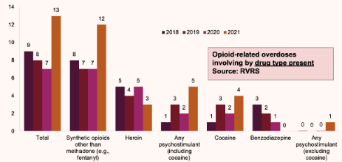
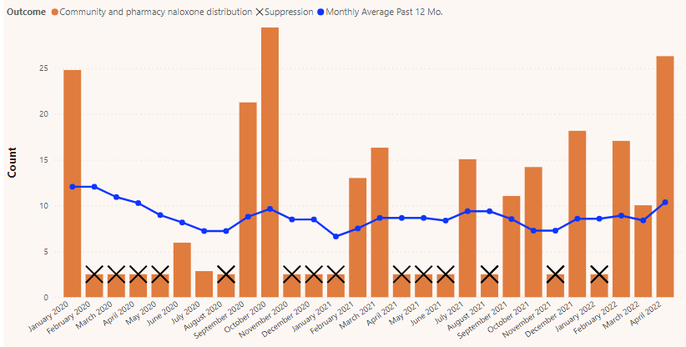

Data Walks
Interactive method to interpret data in a group setting
Share data
Generate discussion
Identify opportunities
What are key take away from these data?
Is this consistent with your understanding locally?
What gaps/opportunities exist?
What additional information would be helpful?

Slide 19
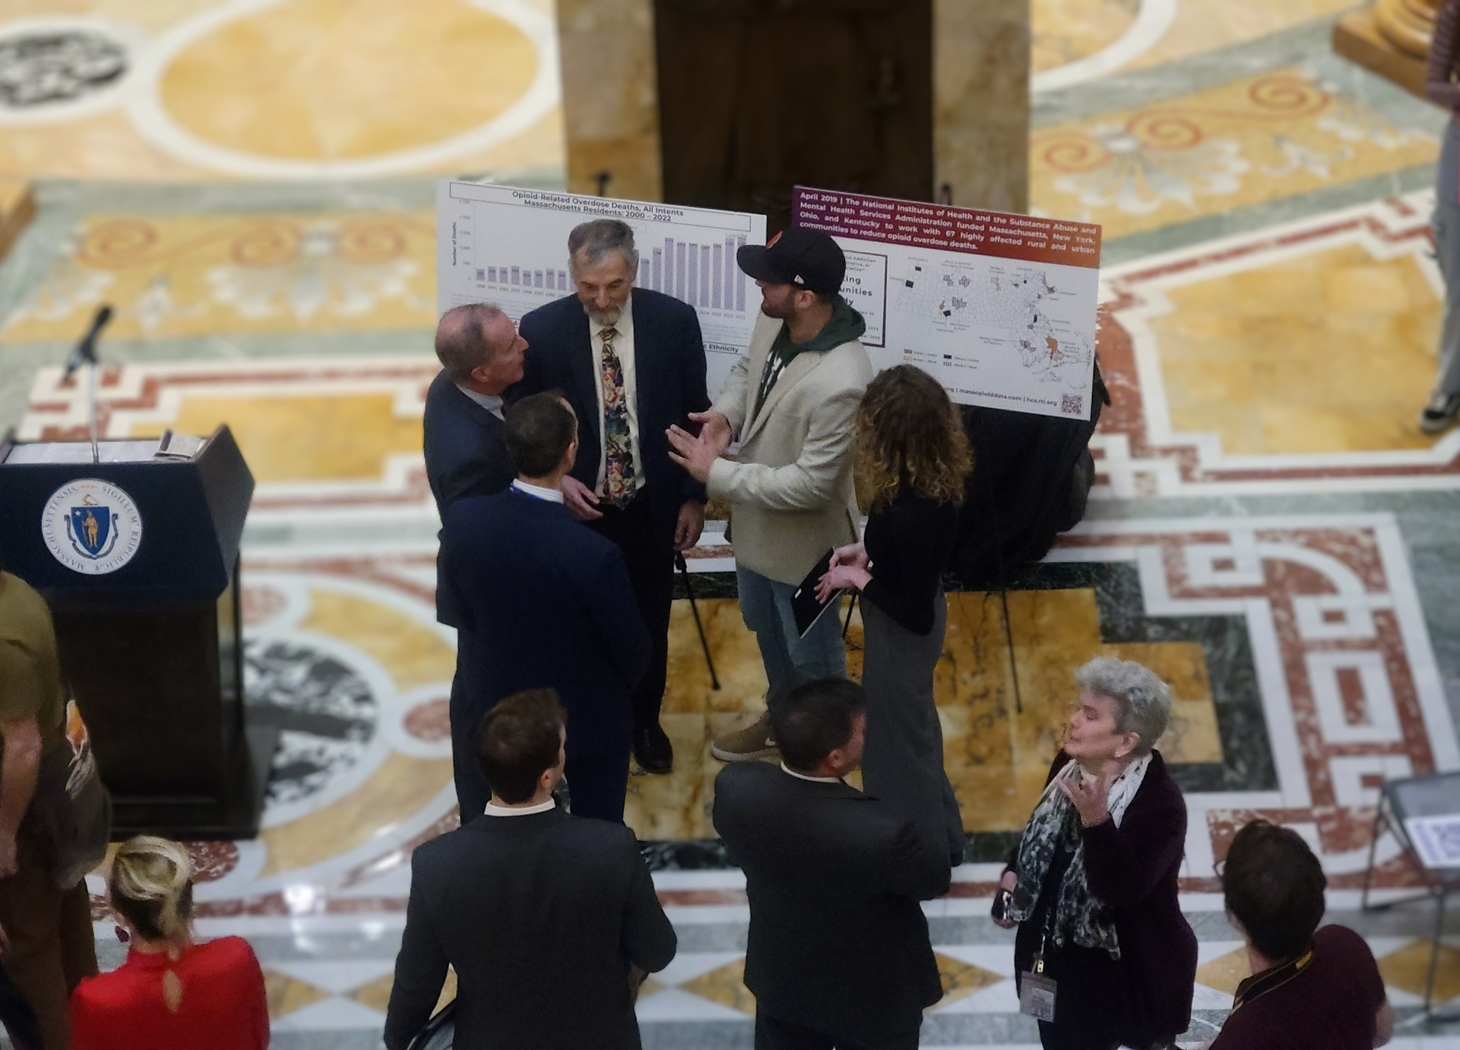
Photovoice
Participatory Action Research method using photography and discussion with the goals to:
Record community strengths and concerns
Promote critical dialogue about important issues
Reach policy makers
Source: Wang and Burris, 1997

Slide 20
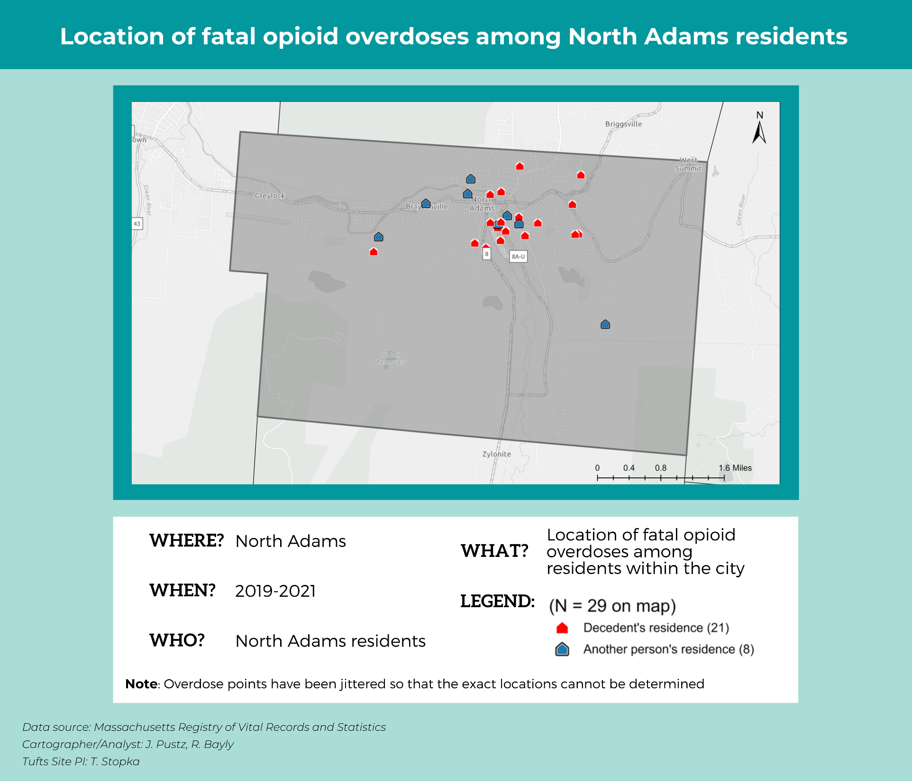
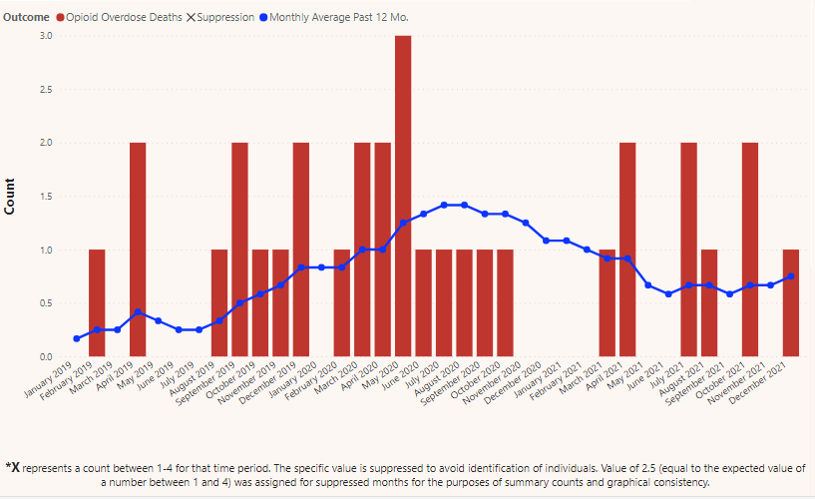
North Adams Data Walk Station
Shared at coalition data walk, August 2022

Slide 21
Coalition Discussion
Overdoses appeared to be clustered at affordable housing complexes & apartment buildings
First responders confirmed frequently responding to overdoses in these locations
Coalition surprised to learn that 100% of overdoses occurred at a residence
As a result:
Coalition members identified the importance of partnering with local housing associations to provide education and resources around overdose prevention
Naloxone needed to be accessible in these building where overdoses were occurring

Slide 22
Coalition Action: Naloxone Box Strategy
Coalition approved naloxone boxes as an OEND strategy in December 2022
Affordable housing complexes were prioritized
North Adams Housing Authority approached for installation in their buildings
Naloxone boxes installed in 5+ locations

Slide 23
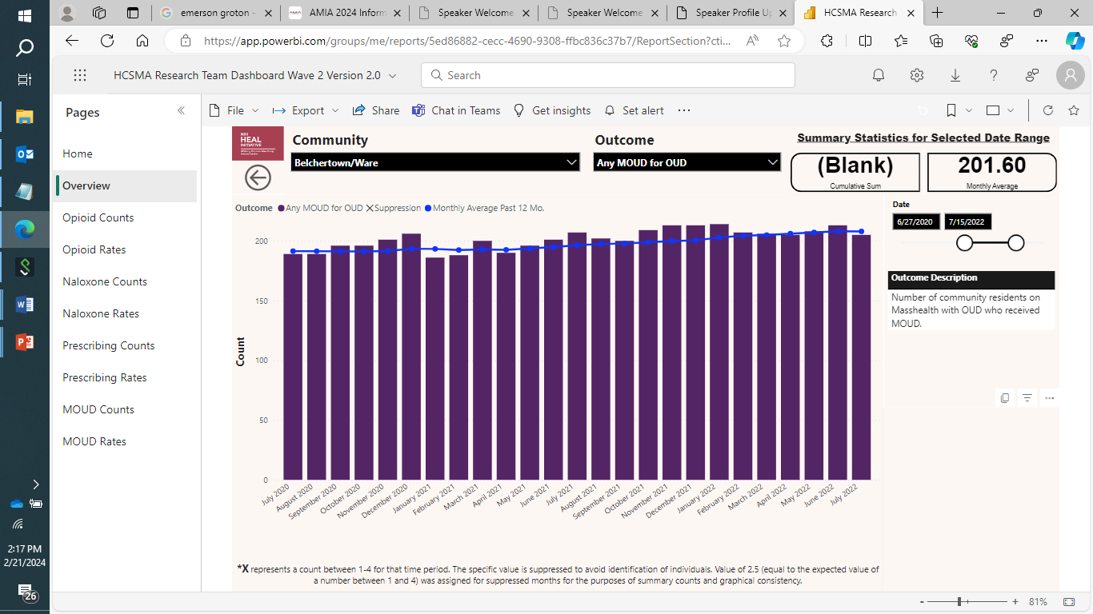
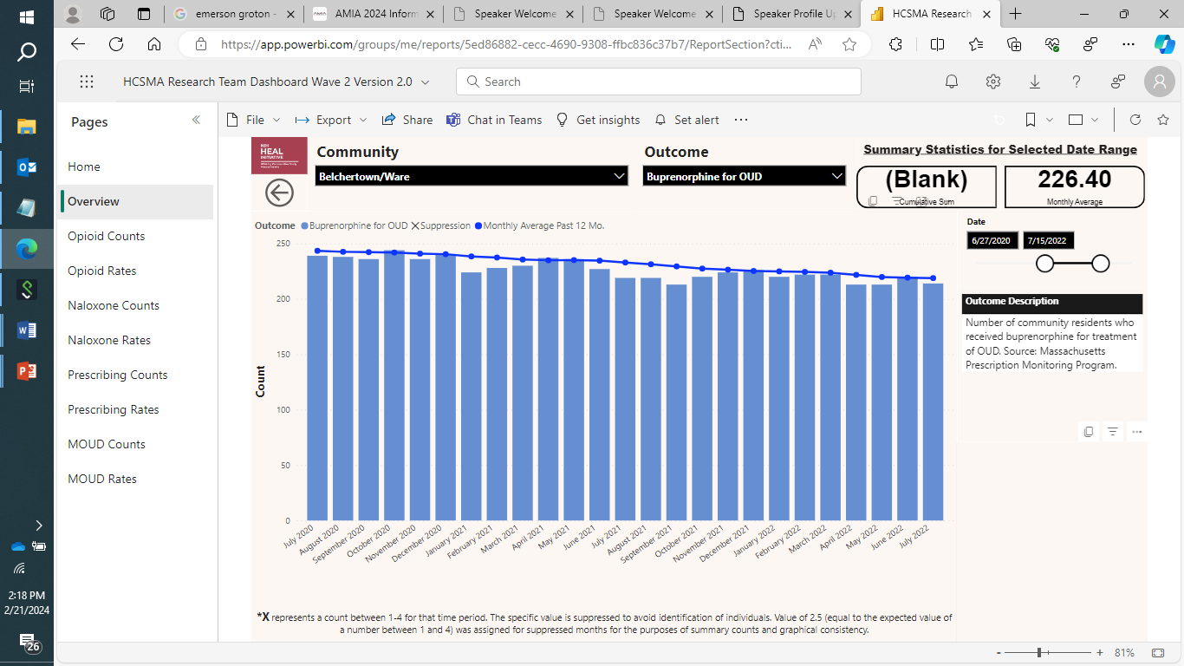
Ware Data Walk Station
TOP: Medication for Opioid use disorder stable over 2 years
BOTTOM: Bupe med has been declining

Slide 24
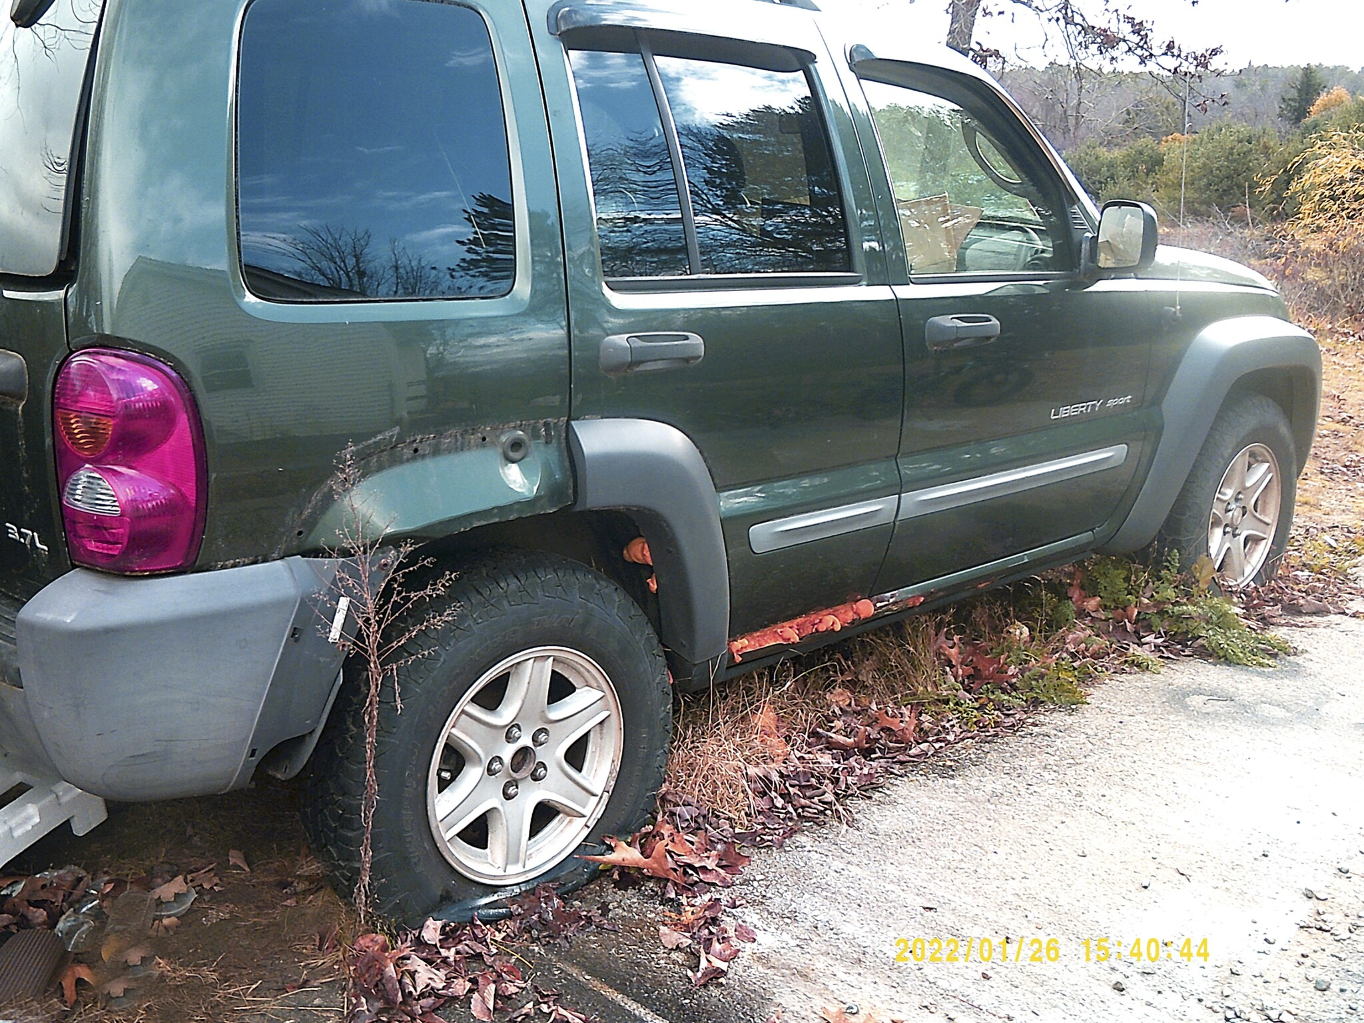
PHOTOVOICE with People with Lived Experience with Opioids
Take-away: Lack of transportation severely limits recreation, recovery, and economic opportunities for residents without a car
“I’ve had this jeep, but have needed to fix it. But without a way to get to a job, I can’t make the money I need to fix it and it keeps me in this cycle of never being able to get my feet under me.”
Notes:
Photovoice participants, most of whom have lived opioid experience, indicated a lack of public transportation in their communities which restricts access to treatment.

Slide 25
Coalition Discussion
Over forty minutes to nearest Opioid Treatment Program
Public transportation very infrequent
Cost of available transport a barrier
Recent closure of hospital in community displaces patients

Slide 26
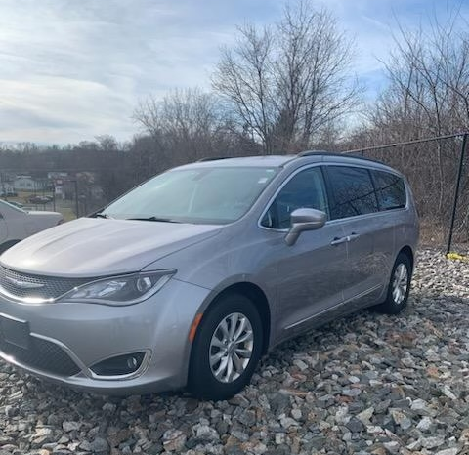
Coalition Action: Low barrier peer transportation service and MOUD linkage via Recovery Center of Hope
Staffing:
RECOVERY COACHES –Two full time coaches responsible for driving the van and recovery coaching responsibilities.
Activities:
Recovery rides to MOUD appointments and other basic needs that support recovery.
Recovery coach support during transportation service use.

Slide 27
Conclusions
Democratizing data is a key step in promoting local data-driven decision making
Dashboard a key step, but benefits from direct engagement and triangulation with other sources
Engagement process helped build culture of dashboard use and data-driven decision-making

Slide 28
Thank you!
Email me at: peter.balvanz@bmc.org

